Slide 1
Introduction
Introduction to Data Science

Slide 2
Outline
What is Data Science?
Applications of Data Science
Data-driven decision making
Roles in a data science team
Data Science lifecycle [Next]

Slide 3
Why Study Data Science?
The question isn’t just "Why study data science?" anymore—it’s "How can you afford not to?"
We are living in an era where data has surpassed oil as the world’s most valuable resource. Choosing to study data science means acquiring the keys to understand, navigate, and shape the modern world.

Slide 4
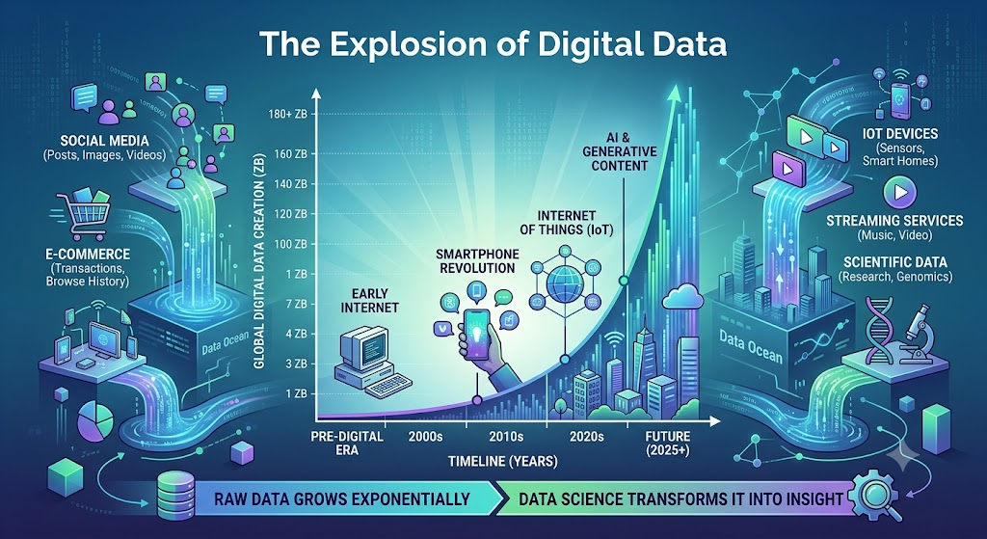
Why Study Data Science?
1. The Explosion of Digital Data
Every click, swipe, share, IoT sensor ping, and online transaction generates data. We are generating zettabytes of data at an exponential rate, creating a massive digital universe.
The Challenge: Raw data is just noise. Without structure, it is completely useless.
The Opportunity: Data science provides the tools—like statistical analysis, data munging, and scalable computing—to mine this digital gold rush. By studying data science, you learn how to turn chaotic, unstructured data into structured, actionable intelligence.

Slide 5
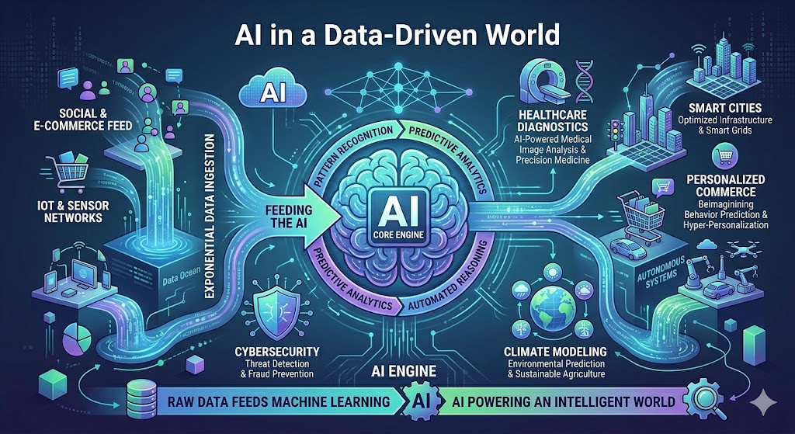
Why Study Data Science?
2. Navigating an AI and Data-Driven World
We have firmly transitioned from software-assisted operations to AI-driven decision-making. Organizations no longer rely on "gut feelings"; they rely on predictive models and automated pipelines.
Core Machinery of AI: Machine Learning (ML) and Deep Learning are not magic; they are applied data science. Studying this field gives you a granular understanding of how large language models (LLMs), computer vision, and autonomous systems actually function.
Algorithmic Literacy: Understanding data science allows you to build, evaluate, and critique the algorithms shaping society, ensuring you are a creator in the AI revolution, not just a spectator.

Slide 6
Why Study Data Science?
3. Unprecedented Industry Demand
The job market for data professionals remains incredibly robust across virtually every sector—finance, healthcare, e-commerce, entertainment, and agriculture.
Versatility: A data scientist isn’t locked into one industry. You could be optimizing supply chains for a logistics giant today, and predicting patient outcomes or disease outbreaks tomorrow.
High Strategic Value: Because data scientists directly impact a company’s bottom line by discovering efficiencies and forecasting trends, they are highly valued, leading to excellent compensation, fast-tracked career progression, and strong job security.

Slide 7
Why Study Data Science?
4. Rich Research Opportunities
If your horizon extends toward academia or advanced R&D, data science is the ultimate frontier. It serves as a powerful catalyst for interdisciplinary innovation.
Solving Global Complexities: The world's most pressing challenges—such as modeling climate change, optimizing sustainable farming practices, or mapping the human genome—are fundamentally big data problems.
Advancing the State-of-the-Art: There is massive research momentum in developing more efficient algorithms, exploring Agentic AI, mitigating algorithmic bias, and perfecting Natural Language Processing (NLP) for under-resourced languages.

Slide 8
Why Study Data Science?
Studying data science is about mastering a universal language. It equips you with a blend of mathematical rigor, computational skill, and domain expertise that allows you to look at a massive wall of numbers and extract human-centric solutions.
Which of these areas resonates most with your current goals? Are you looking at this from a career-pivot perspective, or are you exploring its research potential?

Slide 9
What is Data Science?
Data science starts with data, which can range from a simple array of a few numeric observations to a complex matrix of millions of observations with thousands of variables.
Data science utilizes certain specialized computational methods in order to discover meaningful and useful structures within a dataset.
The discipline of data science coexists and is closely associated with a number of related areas such as database systems, data engineering, visualization, data analysis, experimentation, and business intelligence (BI).
Data science is a collection of techniques used to extract value from data.

Slide 10
Who uses Data Science today?
Almost every organization and business.

Slide 11
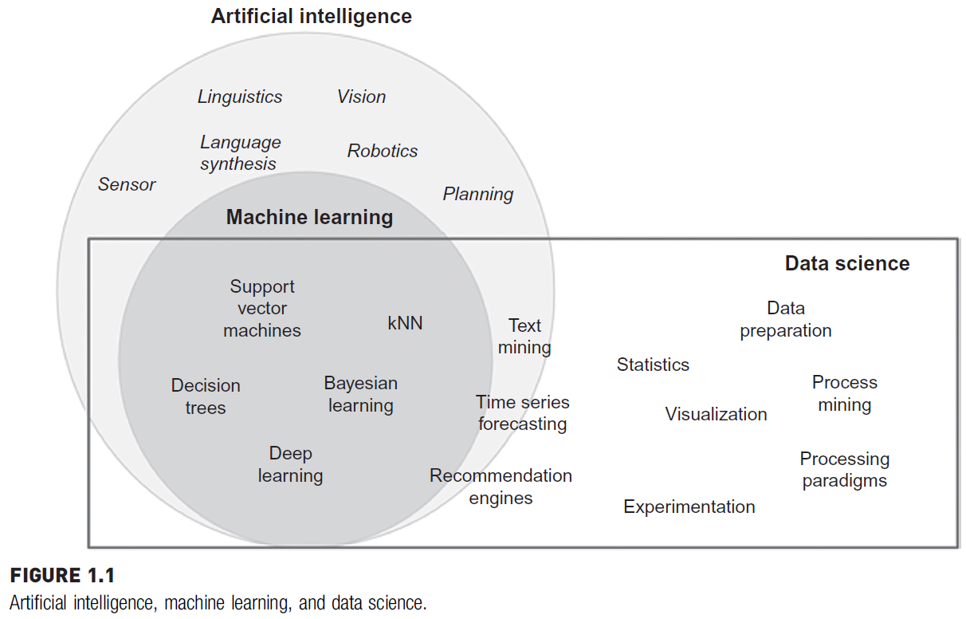
AI, Machine Learning, and Data Science

Slide 12
Applications of Data Science
Healthcare
Disease prediction: Data science shifts medicine from a reactive practice to a proactive science by identifying risks long before symptoms manifest.
  Risk Modeling: By analyzing historical patient demographics, genetic markers, lifestyle choices, and vitals, machine learning models can calculate the probability of a patient developing chronic conditions like diabetes, cardiovascular diseases, or kidney failure.
  Early Oncology Detection: Predictive models look for subtle anomalies in blood biomarkers or genetic sequencing data, flagging high-risk oncology cases at Stage 0 or Stage 1, significantly improving survival rates.
Medical image analysis
Personalized medicine

Slide 13
Applications of Data Science
Healthcare
Disease prediction
Medical image analysis: Medical imaging produces massive amounts of pixel data that computer vision algorithms can digest with incredible speed and accuracy.
  Computer Vision Diagnostics: Deep learning models—particularly Convolutional Neural Networks (CNNs)—are trained on millions of labeled medical images to detect tumors, fractures, microscopic infections, or retinal thinning.
  Enhancing Human Expertise: These tools serve as an advanced second pair of eyes for radiologists, highlighting specific regions of interest on X-rays, MRIs, CT scans, and ultrasounds to minimize human error and diagnostic fatigue.
Personalized medicine

Slide 14
Applications of Data Science
Healthcare
Disease prediction
Medical image analysis
Personalized medicine: The traditional "one-size-fits-all" approach to treatment is being replaced by hyper-targeted healthcare tailored to an individual's unique biological makeup.
  Genomic Sequencing: High-performance computing algorithms process a patient's entire genome to understand how their body will interact with specific chemical compounds.
  Tailored Treatment Plans: Data science cross-references a patient's clinical history with global trial data to determine the exact medication cocktail and dosage that yields the highest efficacy with the fewest adverse side effects.

Slide 15
Applications of Data Science
Business & E-Commerce
Recommendation systems: Instead of showing the same storefront to every visitor, e-commerce platforms use recommendation engines to curate a unique, hyper-personalized shopping experience for individual users.
Customer segmentation: Businesses cannot treat millions of customers as a single monolith. Data science allows companies to automatically organize their audience into distinct, actionable cohorts based on behavioral and financial data.
Sales forecasting: Anticipating future market demand is critical for survival. Sales forecasting utilizes predictive analytics models to transform historical data into accurate timelines of expected growth and market shifts.

Slide 16
Applications of Data Science
Finance
Fraud detection: Financial fraud costs institutions and individuals billions of dollars annually. Data science has shifted fraud prevention from a reactive review process to a proactive, real-time defense mechanism.
Credit scoring: Traditionally, creditworthiness was evaluated using rigid, slow-moving scorecards that relied on limited financial history. Data science introduces automated, highly nuanced predictive models to assess lending risk.
Algorithmic trading: Algorithmic trading uses mathematical models and computational power to execute financial trades at speeds and volumes that are entirely impossible for human traders.

Slide 17
Applications of Data Science
Social Media & NLP
Sentiment analysis: Sentiment analysis (also known as opinion mining) is the process of deciphering the emotional tone hidden within digital text. Rather than simply reading keywords, advanced NLP models evaluate entire context strings to understand how users feel.
Spam detection: Social media channels are constant targets for malicious actors. Spam detection utilizes text classification techniques to maintain communication quality and protect users from fraud.
Chatbots: Chatbots are the public-facing side of NLP on social media and e-commerce platforms, shifting customer interactions from rigid button-menus to fluid, natural dialogue.

Slide 18
Applications of Data Science
Smart Cities & IoT
Traffic prediction: Urban congestion costs cities billions in lost productivity and increased carbon emissions. IoT-driven traffic prediction shifts traffic management from a reactive system to an automated, predictive infrastructure.
Energy management: Traditional power grids operate on a centralized, one-way delivery system that struggles to efficiently balance variable power generation with unpredictable consumer demand. Smart cities use IoT to transition to responsive Smart Grids.
Environmental monitoring: Protecting public health requires continuous, highly localized awareness of environmental factors. Traditional weather stations are spaced too far apart to capture micro-level changes in urban environments.

Slide 19
Data-Driven Decision Making
1. Traditional Decision-Making
Traditional decision-making relies primarily on internal human faculties and legacy knowledge. It is heavily centralized around individuals who have spent years in a specific industry.
Experience: Decisions are anchored in historical precedent. Leaders look at what worked in the past and assume the same playbook will work in the present. This relies heavily on the HiPPO (Highest Paid Person's Opinion) in the room.
Intuition: It is the subconscious mind processing patterns based on years of unquantified observation.
The Vulnerability: While experience is valuable, it is highly susceptible to cognitive biases (such as confirmation bias or recency bias). Furthermore, intuition fails when a market undergoes a sudden structural shift—past experience cannot accurately predict an unprecedented future.

Slide 20
Data-Driven Decision Making
2. Data-Driven Decision-Making
Data-driven decision-making (DDDM) shifts the center of gravity from the individual to the data pipeline. It requires validating strategies against empirical evidence before execution.
Evidence: Instead of guessing what customers want or how a system will behave, decisions are backed by hard, verifiable metrics—such as real-time user telemetry, sensor logs, or financial transactions.
Analytics: Raw evidence is processed using descriptive, predictive, and prescriptive statistical models. This transforms chaotic data into clear, objective insights, showing not just what is happening, but why it is happening and what will happen next.
The Strength: It eliminates guesswork. It allows organizations to remain agile, objective, and capable of discovering hidden market patterns that human intuition completely misses.

Slide 21
Data-Driven Decision Making
Dimension | Traditional Approach | Data-Driven Approach
Primary Driver | Instinct, seniority, and "intuition" | Verifiable data, metrics, and algorithms
Risk Profile | High (dependent on individual human biases) | Calculated (mitigated by statistical probability)
Speed | Fast for single choices, slow to scale | Systemized and automated in real-time
Adaptability | Rigid; relies on old formulas | Highly agile; pivots as incoming data changes
Example | "We should launch this product because I’ve been in this market 20 years and I feel it will succeed." | "We are launching this product because A/B testing shows a 34% higher conversion rate among our core demographic."

Slide 22
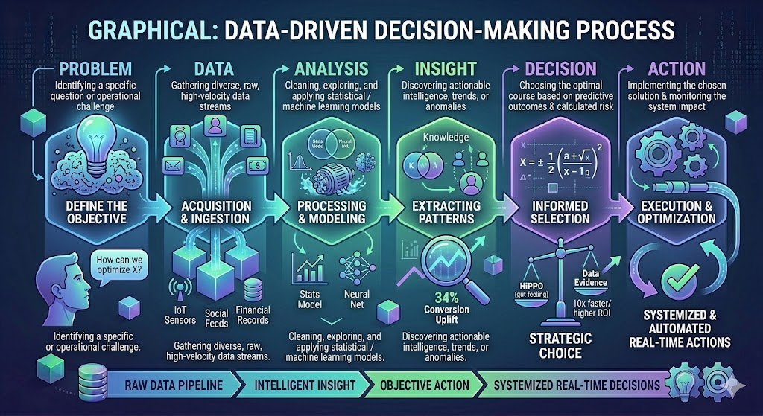
Data-Driven Decision Making

Slide 23
Data-Driven Decision Making: A Case Study
Example: A university wants to reduce student dropout rates.
Questions:
What data would we collect?
What insights might help?

Slide 24
Data-Driven Decision Making
Better accuracy
Reduced risk
Faster decisions
Competitive advantage

Slide 25
Roles in a data science team
1. Data Engineer (The Architect)
Data Engineers build and maintain the foundational infrastructure that allows data to flow smoothly. They are the plumbers and architects of the data ecosystem.
Core Responsibilities: Designing distributed systems, building robust ETL (Extract, Transform, Load) pipelines, and managing big data architectures (like Hadoop, Apache Spark, or cloud data warehouses).
Skills: Python, Java, SQL, NoSQL, Kafka, Spark, AWS/Azure/GCP.
Focus: Data availability, scalability, and system reliability.

Slide 26
Roles in a data science team
2. Data Analyst (The Storyteller)
Data Analysts look at historical data to identify trends, answer specific business queries, and translate complex numbers into human-readable narratives.
Core Responsibilities: Cleaning data, performing exploratory data analysis (EDA), generating descriptive statistics, and building interactive dashboards for business stakeholders.
Skills: SQL, Excel, Tableau, Power BI, basic R or Python.
Focus: Describing what happened and why it happened (Descriptive and Diagnostic analytics).

Slide 27
Roles in a data science team
3. Data Scientist (The Modeler)
Data Scientists take over where analysts leave off. They use advanced mathematics and statistical modeling to look forward into the future.
Core Responsibilities: Engineering complex features, building predictive algorithms, framing business problems into machine learning tasks, and running experimental evaluations (like A/B testing).
Skills: Python, R, advanced statistics, regression, clustering, ensemble methods (like XGBoost).
Focus: Predicting what will happen and prescribing optimal strategies (Predictive and Prescriptive analytics).

Slide 28
Roles in a data science team
4. Machine Learning (ML) Engineer (The Builder)
An ML Engineer bridge the gap between a data scientist's experimental model and a production-ready software system. They make models fast, stable, and scalable.
Core Responsibilities: Optimizing training code, deploying machine learning models into production environments, setting up CI/CD pipelines for AI (MLOps), and ensuring low-latency model inference.
Skills: Python, C++, Docker, Kubernetes, TensorFlow, PyTorch, MLOps frameworks.
Focus: Deployment, code optimization, performance, and model monitoring.

Slide 29
Roles in a data science team
5. Machine Learning / NLP Researcher (The Innovator)
Often found in advanced R&D divisions or cutting-edge tech firms, researchers focus on pushing the boundaries of what AI can do rather than applying existing tools.
Core Responsibilities: Designing novel model architectures, publishing academic findings, and tackling highly specialized domains like computer vision, deep reinforcement learning, or advanced Natural Language Processing (NLP).
Skills: Deep theoretical mathematics, calculus, linear algebra, frameworks like PyTorch, publishing scientific papers.
Focus: Innovation, algorithmic breakthrough, and long-term capability development.

Slide 30
Roles in a data science team
6. Product Manager / Data Translator (The Bridge)
Data initiatives fail if they aren't aligned with business realities. The Product Manager acts as the crucial link between business stakeholders and technical execution.
Core Responsibilities: Defining the project objective, managing the roadmap, translating high-level business goals into specific data requirements, and ensuring the team builds something that delivers tangible ROI (Return on Investment).
Skills: Agile methodologies, deep domain expertise, KPIs tracking, communication, basic data literacy.
Focus: Value delivery, alignment, and project strategy.

Slide 31
Roles in a data science team
Role | Primary Question Answered | Deliverable | Main Tooling
Data Engineer | "How do we reliably store and move this data?" | Clean, accessible Data Lakes & Warehouses | SQL, Spark, Cloud Infra
Data Analyst | "What do our past trends reveal?" | BI Dashboards & Reports | SQL, Tableau, Excel
Data Scientist | "Can we predict future behavior?" | Mathematical & ML Prototypes | Python, R, Stats
ML Engineer | "How does this run for millions of users?" | Scalable, Live AI Services & APIs | Python, Docker, MLOps
Product Manager | "What actual problem are we trying to solve?" | Project Roadmap & ROI metrics | Jira, Docs, Presentation Tools

